Slide 1

ANALYSIS AND PREDICTION OF INDUSTRIAL ACCIDENTS
Date: 23 April 2021
M.Sreelekha : 17WH1A0553
A G Pooja Manas : 17WH1A0537
K.Priyanka : 17WH1A0538
Internal Guide: Ms.G.E. PADMAVATI
Designation: Assistant Professor
Department of Computer Science & Engineering
BVRIT HYDERABAD College of Engineering for Women

Slide 2

PROJECT INTRODUCTION
Why Should I Study this course?
Examples
DOMAIN
Machine Learning
ABSTRACT
In our project, we mainly focused on credit card fraud detection in real world. The motive is to find all the fraudulent transactions that have taken place. Inorder to find whether a transaction is fraudulent or not the model is trained from past credit card transactions that turned out to be fraud. The models that we have used are Decision Tree, Naive Bayes, Support Vector Machine and Random Forest.
BVRIT HYDERABAD College of Engineering for Women

Slide 3

DATASET
The dataset contains transactions made by European cardholders. The dataset contains 492 frauds out of 284,807 transactions. Thus, it is highly unbalanced, with the positive (frauds) accounting for only 0.17%.
There are a total of 31 attributes since the data is highly confidential the attributes are taken as V1 to V28 all being numerical data. The remaining three attributes are time, amount which remains untransformed.
Attribute | Description
V1 to V28 | Numerical Data
Time | seconds elapsed between each transaction
Amount | Transaction amount
Class | Response variable with 1 as fraud and 0 otherwise.
BVRIT HYDERABAD College of Engineering for Women

Slide 4
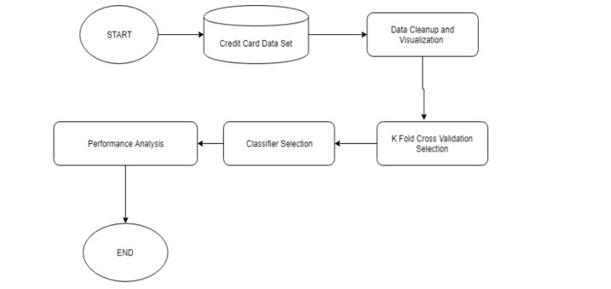
BLOCK DIAGRAM
BVRIT HYDERABAD College of Engineering for Women

Slide 5
SYSTEM SPECIFICATIONS
ENVIRONMENT | SPECIFICATIONS
HARDWARE | Processor - Intel Core i5 Memory(RAM) - 8GB and more Storage - 1TB
SOFTWARE | OS - Windows 10 / Ubuntu Python3
BVRIT HYDERABAD College of Engineering for Women

Slide 6
REFERENCES
Base paper
https://www.ijert.org/credit-card-fraud-detection-using-machine-learning-algorithms
Dataset
https://www.researchgate.net/publication/315644460_Prediction_of_Occupational_Accidents_Using_Decision_Tree_Approach

Slide 7
Thankyou
BVRIT HYDERABAD College of Engineering for Women

